Slide 1
REED RANCH ROUND UP
33007 Rge Rd 280
Mountain View County, AB
T4H 4B6
(403) 556-2429
www.reedranch.ca
December 2024
PRINCIPAL’S MESSAGE
Follow us on Facebook
It seems hard to believe December has arrived! Only a few short weeks ago, we were without snow, Winter and Christmas seemed such a long way off!
This is a busy month for students and staff at Reed Ranch School! Along with continued academic learning in classrooms, preparations for the Christmas concert are well underway.
For our new Reed Ranch families, we know your child(ren) will enjoy the experience of being part of all the special activities both staff and our dedicated parent council work to provide to make this time of year extra special for students. It truly is a wonderful time of year.
A few new items of note have been added for this year to provide our students with the opportunity to spread some Christmas Cheer to others. They are:
Carol Sing: December 17th
Reed Ranch sings at Mountainview Lodge and Encore
Thank you to RR Parent Council for funding busing costs!
Secret Santa for Seniors
Reed Ranch School will be providing gift bags for seniors who call Olds Continuing Care home. Thank you to the generous financial support of Parent Council of this project.
Wishing you all a wonderful December! I look forward to seeing families on the 12th at the Christmas Concert.
Warm Regards,
Erin Machell
Please join us for our
Annual Christmas Concert
“Gnome for the Holidays”
Thursday, December 12th
7:00 pm
(We ask that students be in their classrooms at 6:30 pm)
THANK YOU to the Olds Westview Co-op for the generous donation of 200 oranges for our Christmas Concert.
NEW!! CLASSROOM NEWSLETTER LINKS
Ms. Machell: Kindergarten Ms. Cranston: Grade ¾
Ms. Tetzlaff: Grade 1/2 Mr. Seidel: Grade 5/6

Slide 2
IMPORTANT! PLEASE NOTE
If your child will be traveling on a bus (which is NOT their regular means of transportation) to a friend’s place after school, the following communication must take place for the child to legally be allowed on the bus:
If you are the receiving parent:
Please notify your bus driver that another child will be accompanying their child. Email or text message are both acceptable.
If you are sending your child on the bus:
Please notify your child’s teacher by email who your child will be going home with and when.
If this information can be shared the day before, it is greatly appreciated.
Students who miss 15 days of school per year will miss a year of school before Grade 12.
A student with 90% attendance will miss 4 weeks of school per year.
Being 10 minutes late for class every day means the student will miss 6 days of instruction over the year.

Slide 3
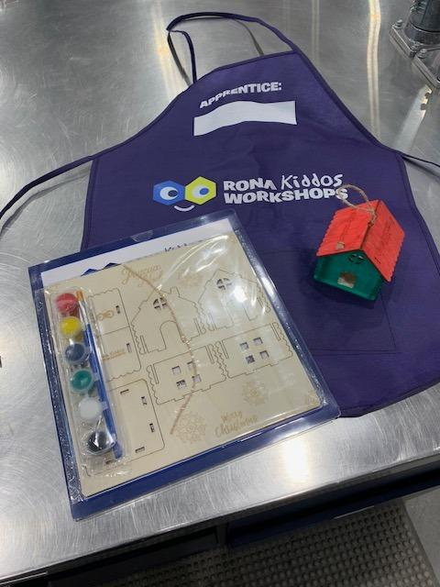
Small box containers are $15 each and the large container is $20 each
Kids Workshop at Rona on December 7th!
Bring the little ones out for creativity and holiday cheer!
What’s Happening?
Kids will build and paint their very own Christmas tree decoration – the perfect gift or keepsake for the season! Plus, each child will receive a Rona work apron to take home.
Two Workshop Times- Max 25 kids per session
- 10:00 AM
- 2:00 PM
Details:
- First come, first served!
- Minimum $5 donation per child (all proceeds will go to Clint's Kitchen to help feed those in need this holiday season).
Festive Caroling Extravaganza Field Trip
We're excited and looking forward to a joyful Christmas Caroling event for our students! Let's spread holiday cheer together by singing Christmas carols at two special locations:
Olds Mountain View Lodge
Time: 9:30 AM - 10:00 AM
Olds Encore Seasons
Time: 10:15 AM - 10:45 AM
Date: Tuesday, December 17th
Transportation: Student transportation will be provided by bus. Check your email for the field trip link. Must be completed by Dec. 10th please.
Let's make this a memorable Christmas season filled with music and joy!

Slide 4
Hot Dog Day
Thursday, Dec. 5 & 19
Order online through Student Quick Pay on our website.Please DO NOT e-transfer Parent Council this money as it is a school generated fundraiser.
Hot Dogs sell for $1 each.Hot dog days are usually the 1st and 3rd Thursday of every month. Please check the calendar on our website.www.reedranch.ca
December 12 - Pizza Lunch
Watch for more lunch order forms to come home soon.
Looking for school swag? Find it here
Diego in ECS on December 1
Ella in Grade Six on December 5
Marcus in Grade Two on December 12
Charlie in Grade Four on December 16
Nicholas in ECS on December 18
And
Karen in Grade One on December 24
PARENT COUNCIL
The last meeting was Monday, November 25.
If you missed the meeting and want to read the minutes they are posted HERE.

Slide 5
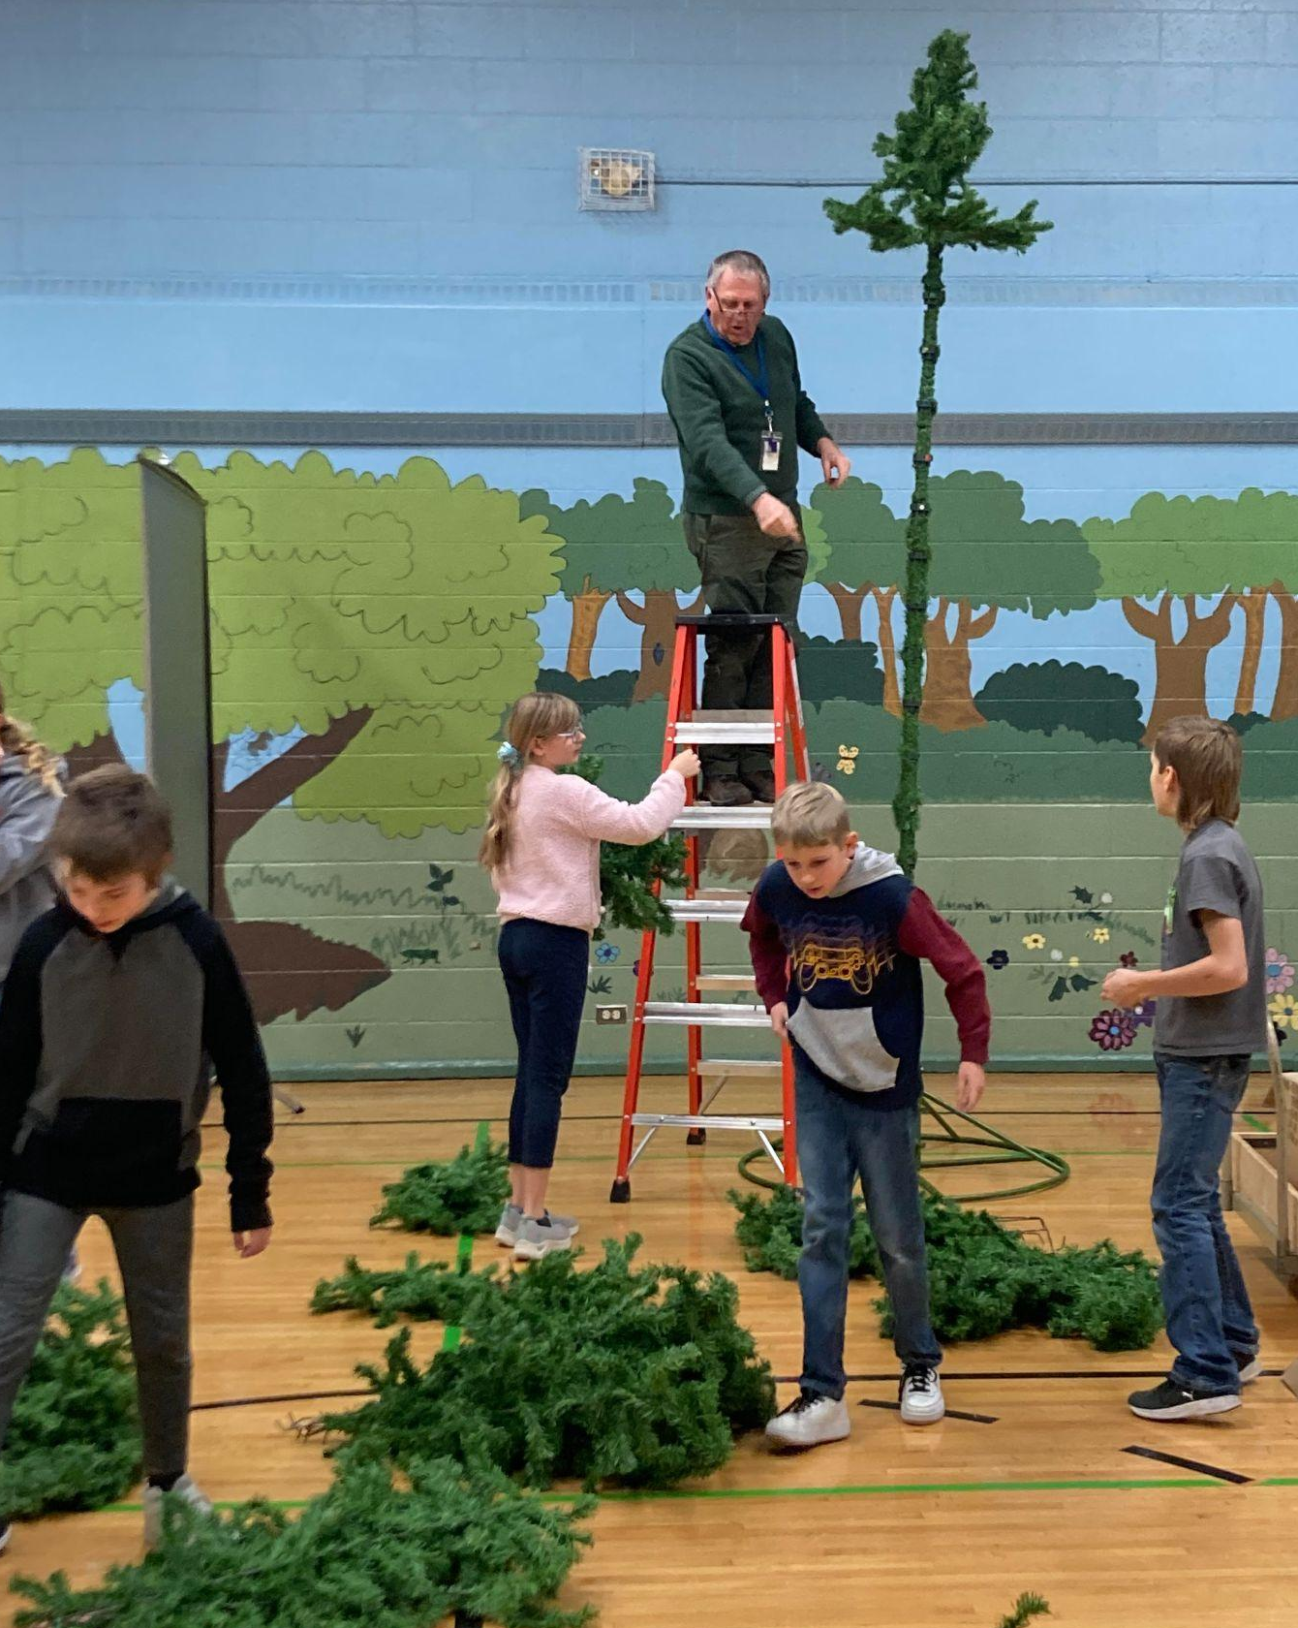
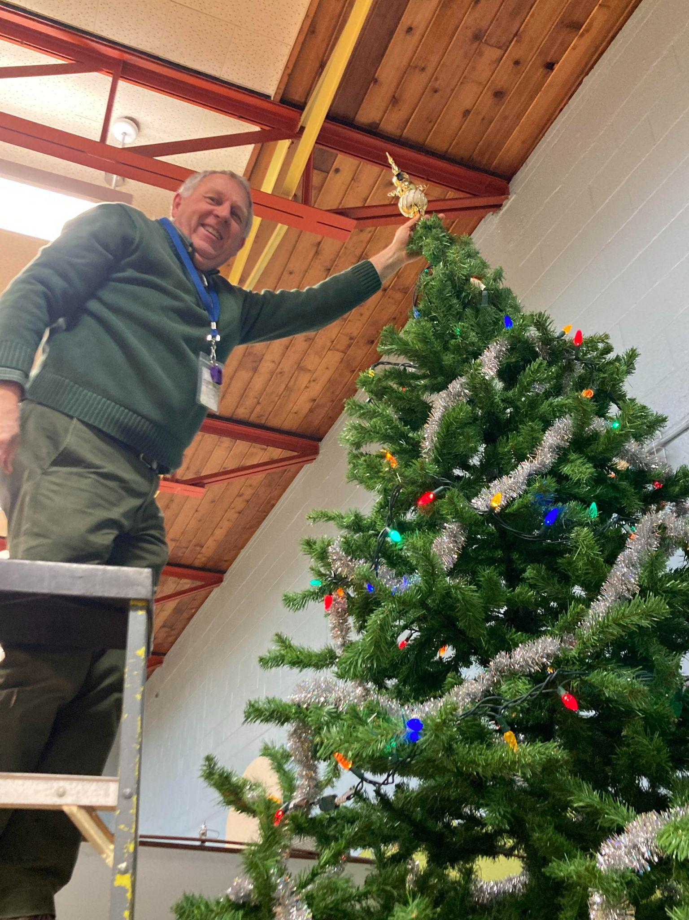
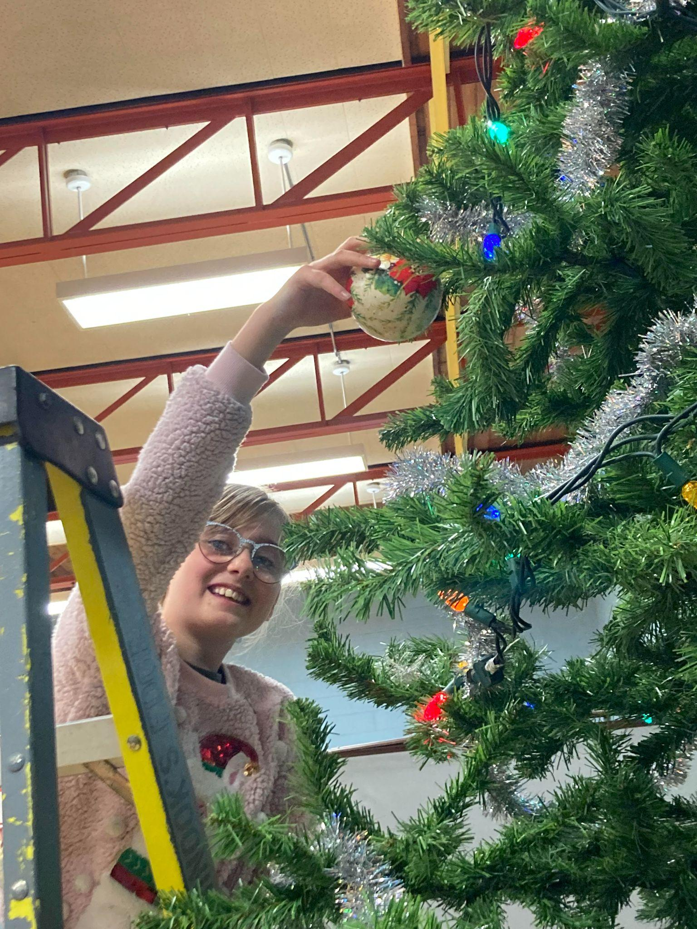
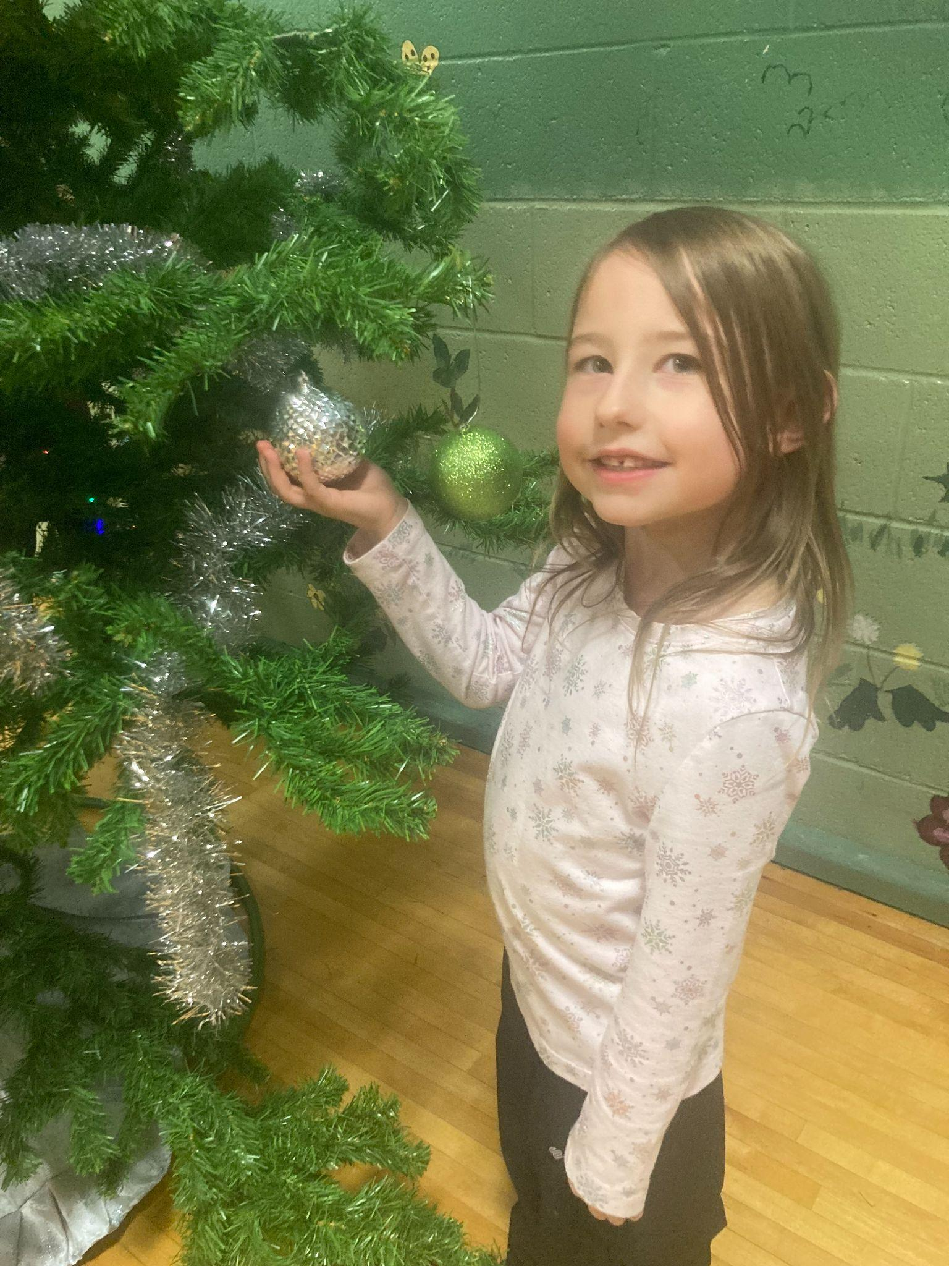
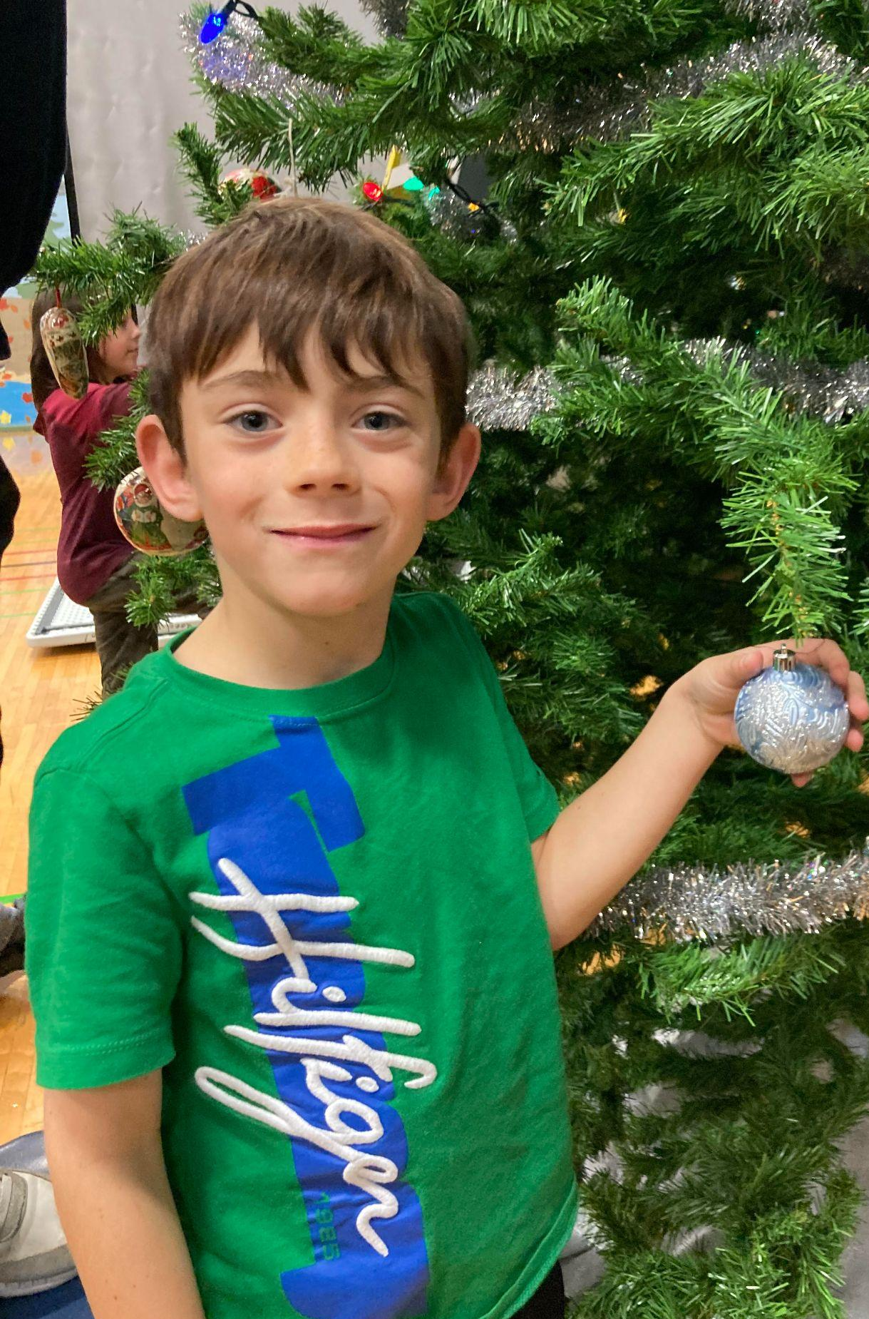
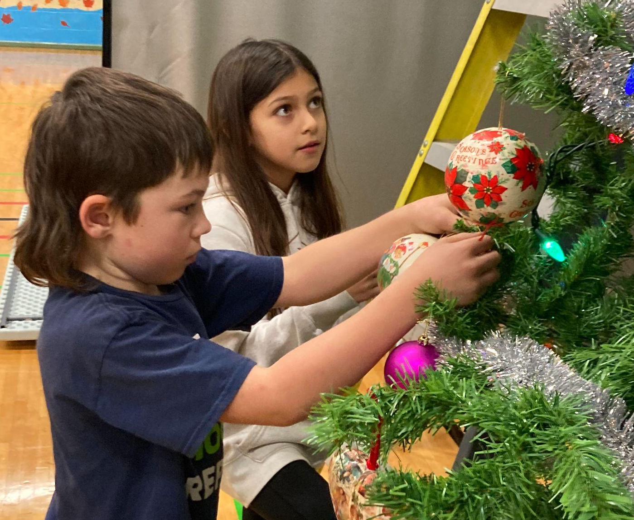
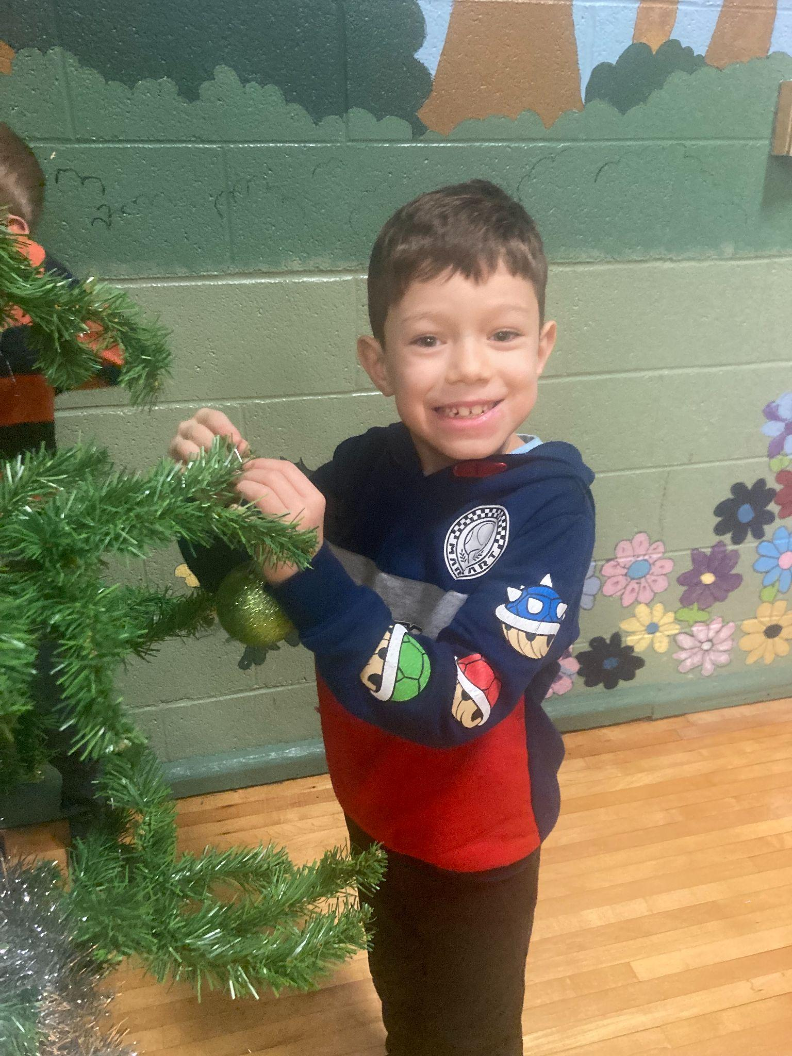
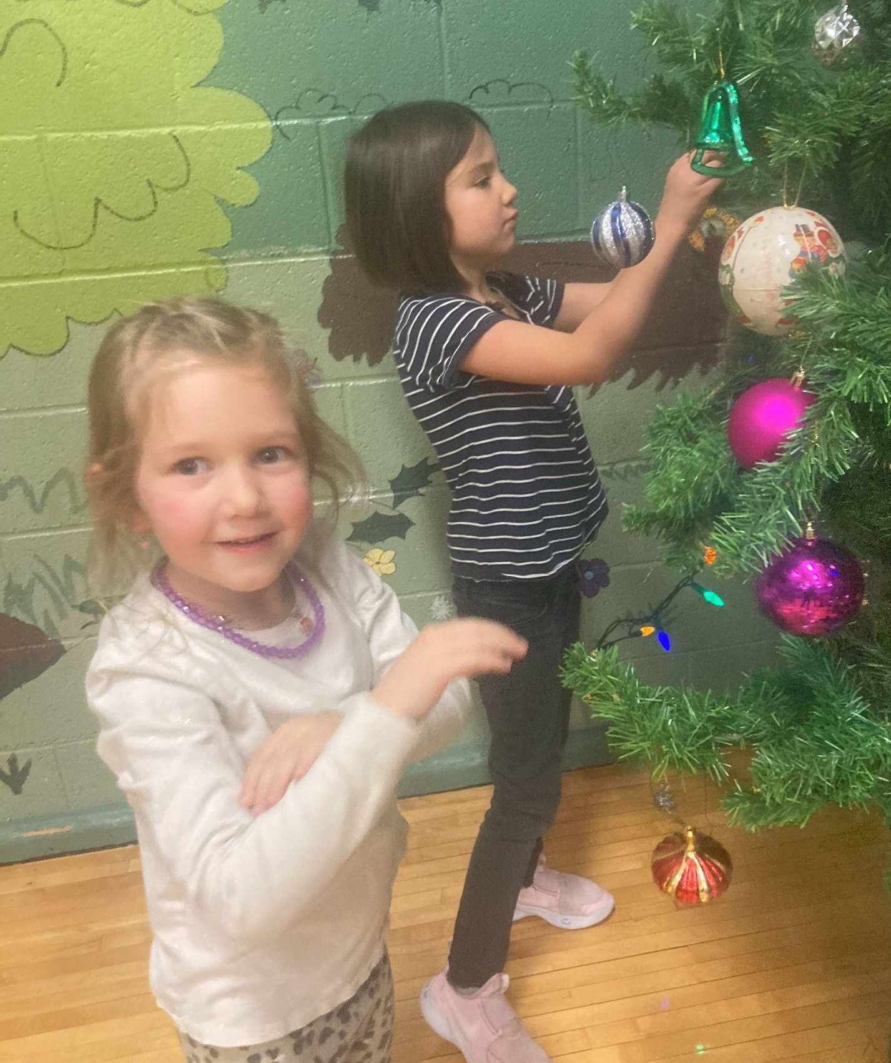
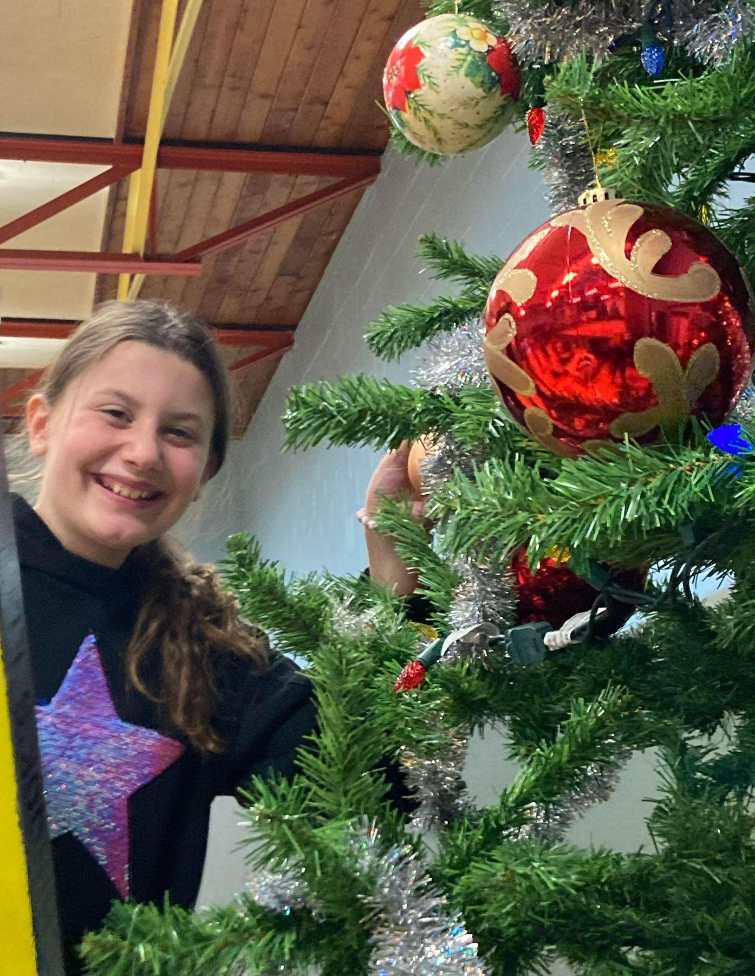
Up goes the BIG Christmas Tree…..

Slide 6
DECEMBER 2024
Sunday | Monday | Tuesday | Wednesday | Thursday | Friday | Saturday
1 | 2 | 3 | 4 | 5 Hot Dog Day Santa/Elf Hat Day | 6 RR Non School Day Cookie Walk 4-6pm | 7
8 | 9 Raffle tickets to be returned today | 10 Field Trip forms to be completed online. Due today. | 11 Grinchmas 3:30 - 6pm | 12 Christmas Concert 7pm Ugly Xmas Sweater Day Pizza Lunch | 13 RR Non School Day | 14
15 | 16 | 17 Singing with Seniors | 18 | 19 PJ / Movie / Craft Day Hot Dog Day | 20 RR Non School Day | 21
22 | 23 Christmas Break | 24 Christmas Break | 25 Merry Christmas | 26 Christmas Break | 27 Christmas Break | 28
29 | 30 Christmas Break | 31 Christmas Break | 1 Christmas Break | 2 Christmas Break | 3 Christmas Break | 4 Christmas Break Back to school January 5

